Slide 1
Functions/Methods, Scope and structure
CT4027 – Tools Programming

Slide 2
In this session…
Arrays (basics)
Reference and Value types in C# (basics)
Defining and using functions
Passing values with ref and out
Tuples, and how to return them
Variable scope, or where has my variable gone?
Good program structure

Slide 3
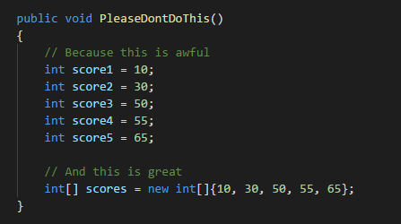
Arrays – Why?
We have covered variables of different types.
Arrays hold many values of the same type
You can avoid code duplication
Easy to loop through multiple items

Slide 4
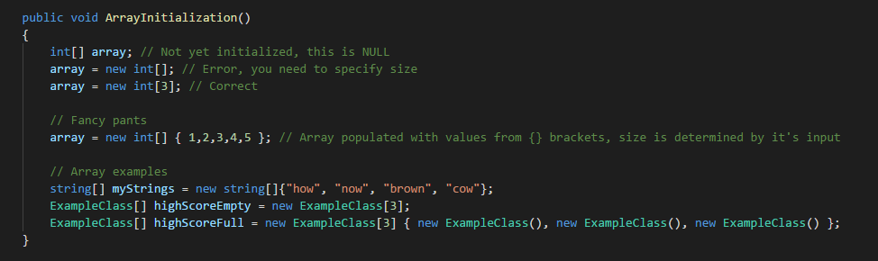
Arrays – Initialisation
Use square brackets to define array
Arrays have to be initialized with a fixed-size
Default values are populated if not specified
Use the array initializer if you have the values

Slide 5
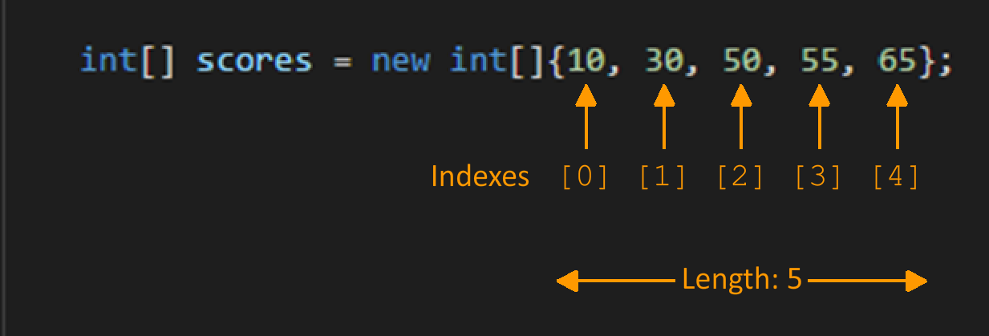
Arrays – Indexing
Arrays contents have an index
This is what position an element is in the array
Indexes start from 0

Slide 6
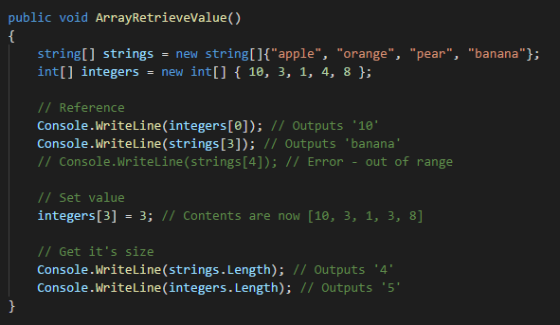
Arrays – Get & Set Values
Use the square brackets with an index to access the variable

Slide 7
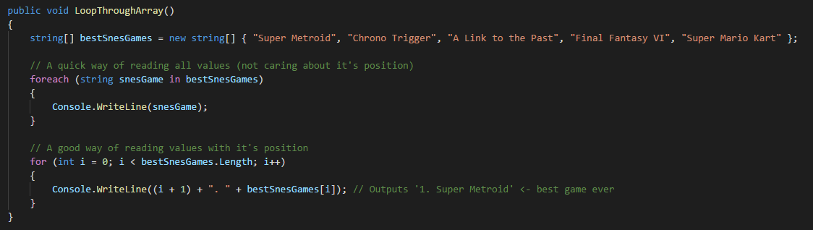
Arrays – Looping
You can use loops to read/write to an array
You can use foreach, for, while, do while

Slide 8
Arrays – AlternativeTo
It’s not just arrays that store multiple values
List, ObservableCollection
LinkedList
Queue, Stack
Dictionary, HashSet
Just to name a few

Slide 9
Task #1
Write a C# program that will populate an array with the numbers from 1 to 100
Modify your program so that it will loop through this array and print these numbers out
Modify your program so that for multiples of 3 it will print out “Fizz”, for multiples of 5 it will print out “Buzz” and for multiples of 3 and 5, it will print out “FizzBuzz”
Bonus: Write a C# program that will swap the values of two integer variables, without using a third variable

Slide 10
Reference and Value types
Value types in C#: float, double, int, string, byte, any struct
Value types are located on the stack (quick memory)
Value types always have a value (not nullable)
When passing value types, they are cloned
Reference (complex) types: array, any class, interfaces, delegates
Reference variables are located on the heap (larger slower to access memory)
Reference types can be null
When passing reference types, they are directly linking the original data (you modify the original)

Slide 11
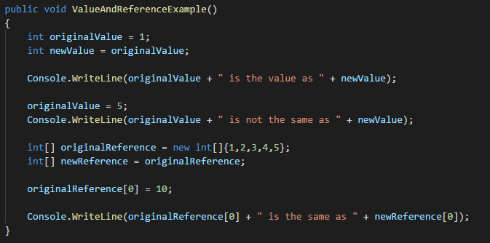
Reference and Value types - Example

Slide 12
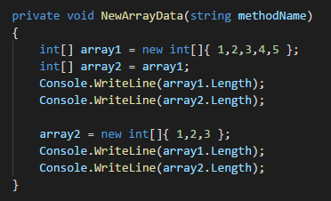
Reference and Value types – Example2
Reference type variables point to data, this means they can point to new data too

Slide 13
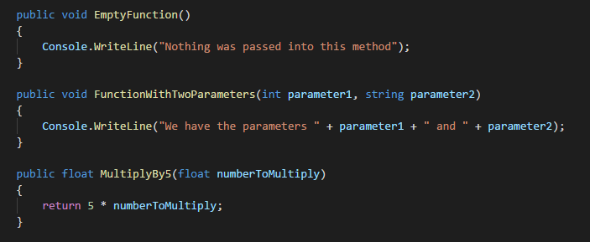
Functions/Methods - Defining
Functions contain:
Access Modifier (optional)
- Who has permission to call
Return Type (or void if it doesn’t return)
Function Name (pascal case)
Parameters within brackets (please use camel case for names)

Slide 14
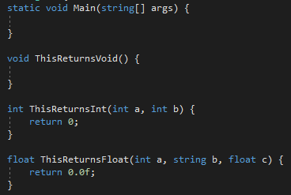
Functions/Methods - Returning
To return, simply write ‘return’ then a value
Functions that return must always return a value
Returning can exit the function early
When calling a returning function, you can use the returned value (if you want)

Slide 15
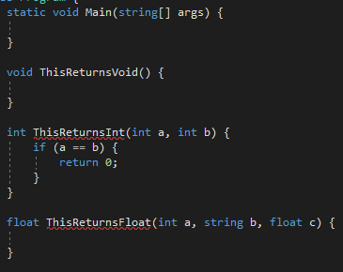
Functions/Methods - Returning
Why are the last, and second to last methods here incorrect?

Slide 16
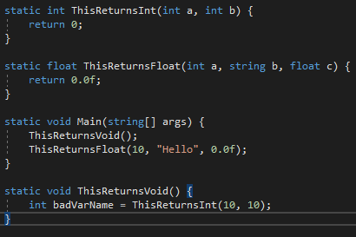
Functions/Methods - Calling
When we call a method, control goes to the method we have called
When that method returns, we drop back to the same spot in our original function, either with or without the value returned (depending on whether there was one)

Slide 17
Function/Methods - Calling
When you call a method control is passed to that method
It then returns to the calling method
When we have a return variable, we do not have to use it in C#
We always need to pass all the expected arguments, however

Slide 18
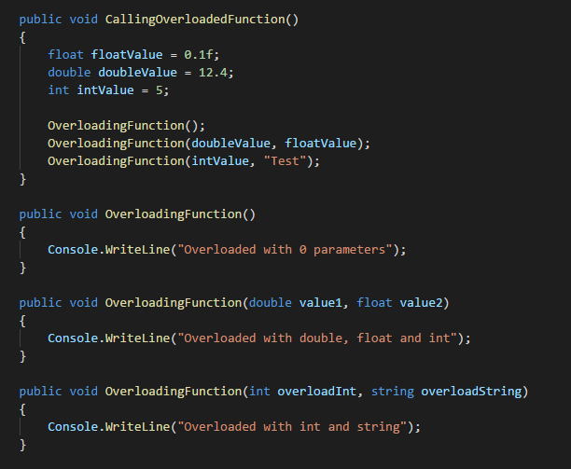
Functions/Methods - Overloading
You can have the same function name used multiple times
They must have different parameter types
They must all share the same return value

Slide 19
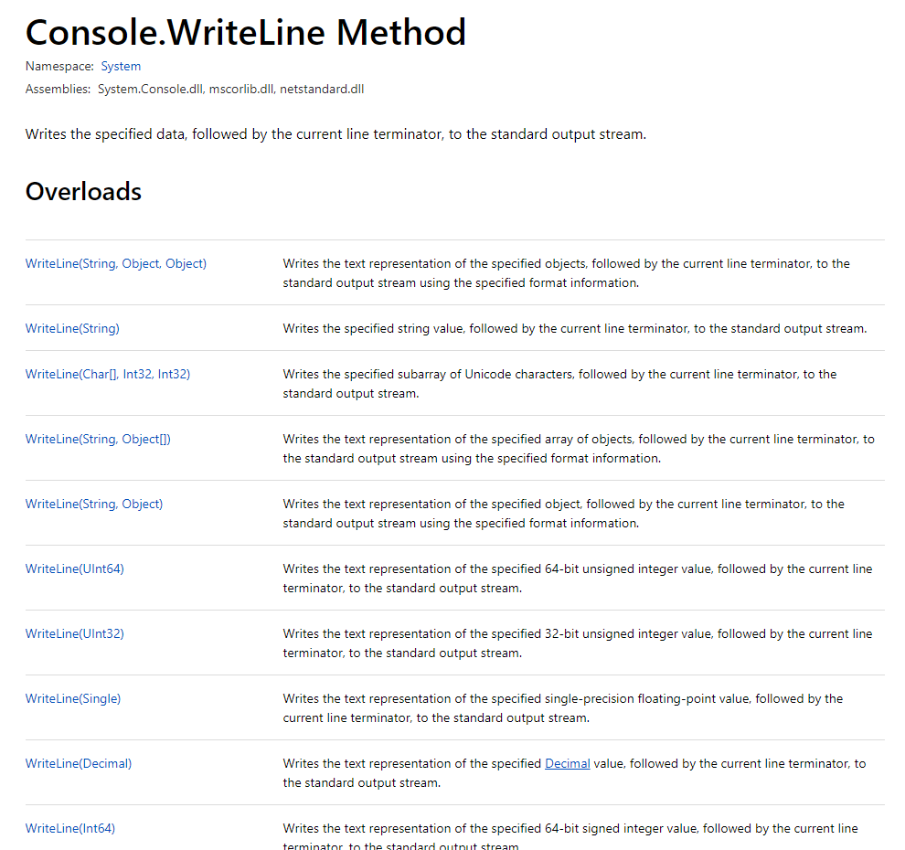

Slide 20
Task #2
Modify your fizzbuzz program from before to use different methods and their returned values
Write a C# program that given the string “Hello it is a lovely day, nice to meet you!” will reverse the characters of each word in the string. You may use any built-in C# features to complete this so feel free to research them. Break your code into methods.

Slide 21
Different kinds of parameters - Ref
When you create a function that takes a ref parameter, you are not cloneing that variable to the function, you are giving the function a way to access the original variable
main()
Calls Increment(count);
Increment(int b)
Variable: count
Variable name: b
Computer memory:
count: 1
b: 1
count: 1
main()
Calls Increment(ref count);
Increment(ref int b)
Variable: count
Variable: b

Slide 22
Ref parameters
So using ref parameters, kind of forces a value type to behave like a reference variable as far as being passed between methods is concerned
To pass a ref parameter to a method, the value of that variable must already be set
So what happens when we pass a reference type using the ref keyword?
Nothing much changes, except that if we change the memory location that our reference points to in the called method (by creating a new object using the same name, for example), it will change the original reference in the same way

Slide 23
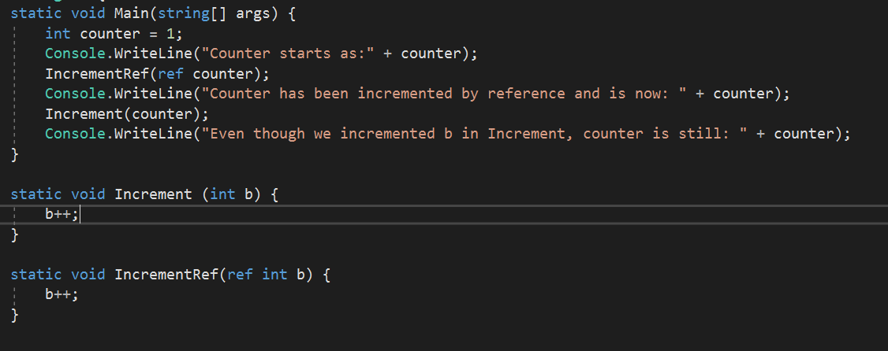
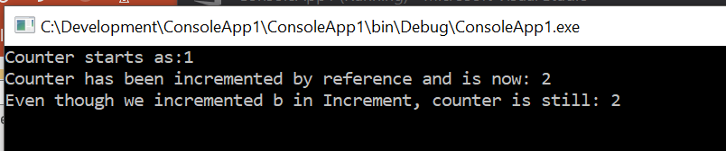
Ref parameters - example

Slide 24
Out parameters
Out parameters behave very similarly to ref parameters, with one important caveat
A variable passed by an out parameter to a method does not need to be set before it can be passed
And must be set within the called method before that method can use it, or finish
Normally a ref is used you want a method to modify an already existing variable, an out is used when you want a function to have an extra output (beyond its return variable)

Slide 25
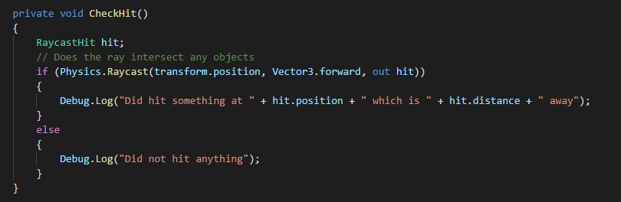
Out parameters - Example

Slide 26
Tuples
Another trick to return multiple variables, and avoid using “outs” or “refs” is to use tuples
Tuples are a really neat and new feature in C#
This will not work nicely in Unity yet – because Unity is using an old version of C# that does not support these features
To use this you will need to make sure that under project properties, application, target framework, .NET 4.7 is selected
There are a number of ways to use tuples, by defining types, by assigning results directly to variables, or by using a var keyword to let C# create a type with named components
The easiest way to explain this is to show the code

Slide 27
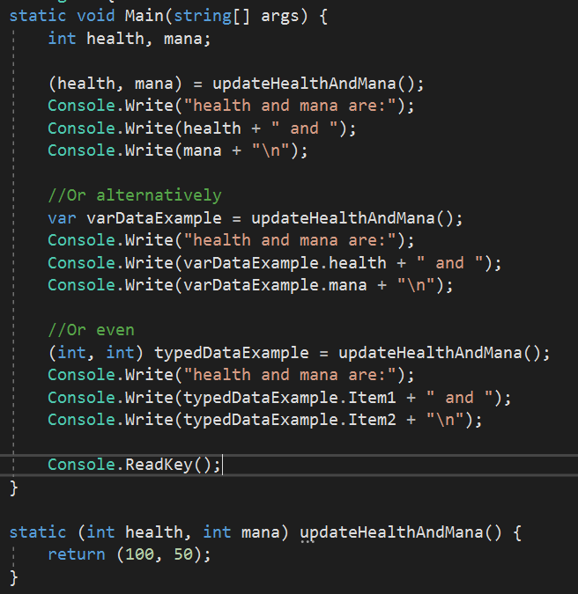
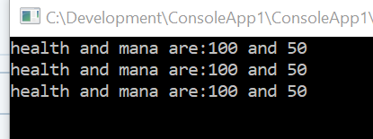
Tuples demonstration

Slide 28
Variable scope in C# basics
When a variable is created inside a code block in a method (usually a set of curly braces {}, like an if statement or a switch statement) it exists only until that code block ends
When a variable is created directly inside the method (i.e. not inside any inner code blocks in that method) it exists until that method ends
Variables declared outside of a method must be declared inside a class. Variables declared as part of a class exist until that class is cleaned up by the garbage collector

Slide 29
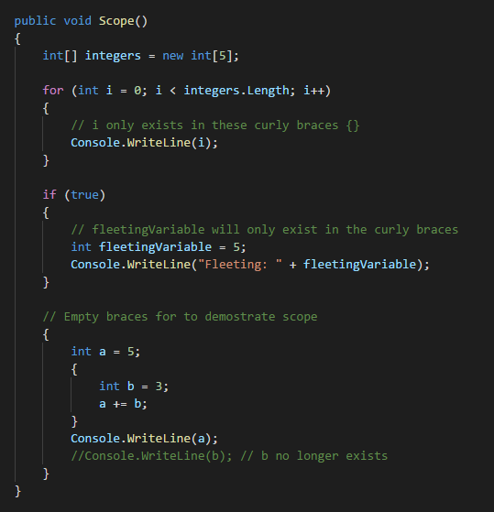
Variable scope in C# - Inside Function

Slide 30
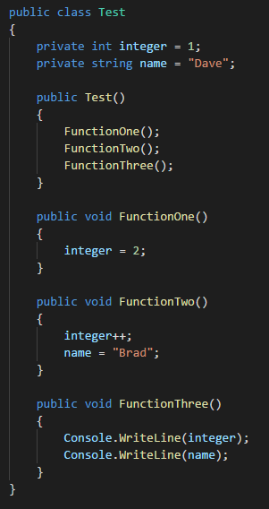
Variable scope in C# - Inside Class

Slide 31
Good program structure
Follow the coding guidelines!!
Break your code into lots of methods – not necessarily one liners, but ideally each method should be doing one very clear thing, not a whole lot of things.
If you copy and paste a section of code, can it go inside a method with parameters?
Pass variables between methods when it makes sense, but if a lot of methods are using the same variables, consider making these class variables – think about your scope
As time goes on, and you read other peoples code and write more of your own, you should get a “feel” for when code is good and when it is bad

Slide 32
Good program structure continued
Naming is important
Name functions correctly. Do not simply use nouns. ‘Player()’ is bad, ‘MovePlayer()’ is good.
Use plurals for arrays, int[] highscores; You know it’s an array before reading the type.
Don’t use single letters if you can help it (i, j, k).
Use the name ‘index’ if you are counting from zero in an array. (eg: int highscoreIndex).

Slide 33
Any Questions?

